Slide 1
19
Debugging C# in Visual Studio 2017

Slide 2
Objectives
Describe the concept of debugging in Visual Studio 2017
Identify the different ways of debugging C# applications
Explain the process of installing, updating, and removing NuGet packages

Slide 3
Introduction to Debugging
Debugging is a process that tracks an application by going through its each line of code.
Visual Studio 2017
Allows changing values to see the possible outcome while the application is in its running state.
Provides wide set of debugging tools.
Indicates status of running code.
Allows debugging of C# applications.

Slide 4
Debugging Tools in Visual Studio 2017 1-2
Default Build Configurations
Release configuration is for distributing the final version.
Release
Debug configuration is for debugging the application code.
Debug
Figure indicates that Visual Studio is set to compile the opened application in the Debug mode.
Debug Mode

Slide 5
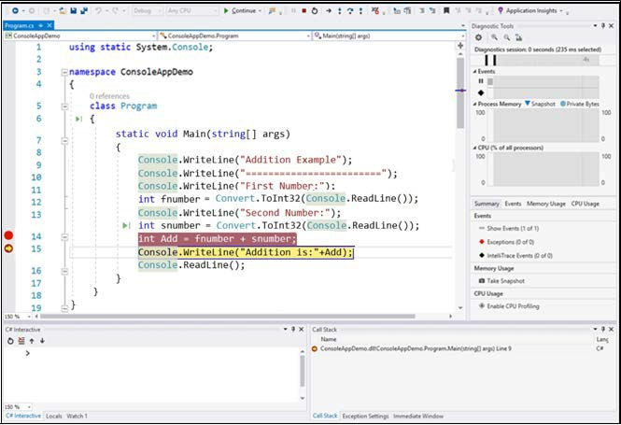
Debugging Tools in Visual Studio 2017 2-2
Debugging Environment in Visual Studio 2017

Slide 6
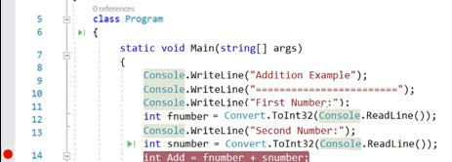
Using Breakpoints 1-2
Breakpoint:
Refers to a signal that stops the application’s execution at the already set points in the editor.
Pauses execution prior to running the line of code having the breakpoint.
Waits for the next instruction or command to proceed.
Allows breaking the execution at any line of code with the help of debugger.
Breakpoint

Slide 7

Using Breakpoints 2-2
Ways to run debugger:
Press F5
Click green- play Icon on the toolbar
Select Debug→ Start Debugging

Slide 8
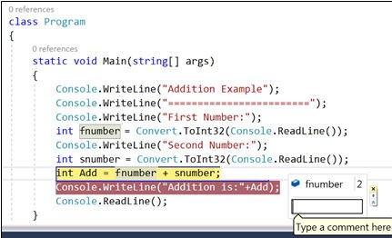
Using Data Tips
Data Tip:
Informative tooltips available only in break mode.
Reveals more information about a selected variable or an object in the present execution scope.
Data Tip
Can be pinned and can be commented.

Slide 9

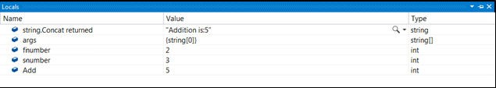
Using Windows and Conditional Breakpoints 1-3
If a developer sets a breakpoint on the line that prints user input, the Autos, Locals, Immediate and Watch windows are quite useful to observe.
A window that displays the information of all variables and
Autos
objects such as type and value that are in the present or the previous line.
Autos Window
Locals
Shows the values of local variables and objects that are within the scope of current execution.
Locals Window

Slide 10
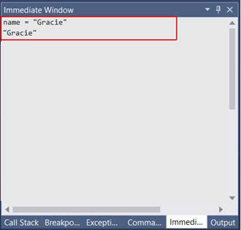
Using Windows and Conditional Breakpoints 2-3
Immediate: A window that allows changing the values.
Immediate Window
Watch: A window that display information about variables and objects depending on the changes made to them.
10

Slide 11
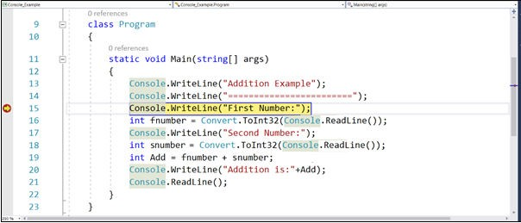
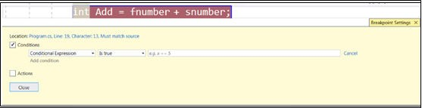
Using Windows and Conditional Breakpoints 3-3
Code in Debug Mode
Breakpoint Settings Dialogue Box

Slide 12

Using Run to Click
Aims to simplify the debugging steps.
At this line, the debugger breaks and waits for the next command.
Informs the debugger to execute until it arrives at this line.
Run to click
Useful for debugging from one line to another in a block by simply clicking the icon.
Run to Click Feature

Slide 13
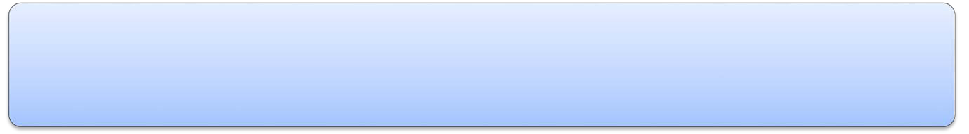
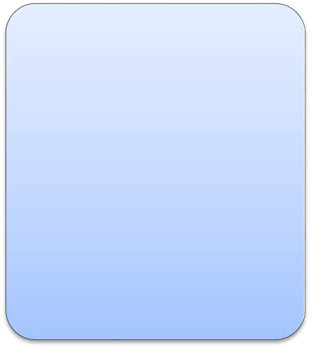
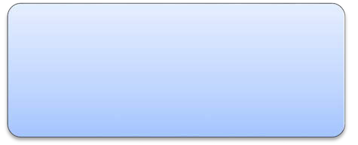
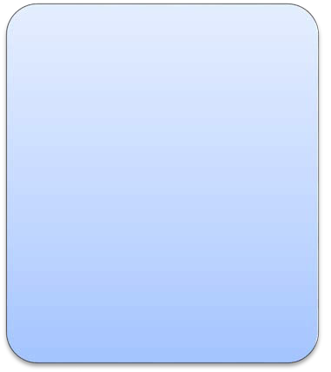
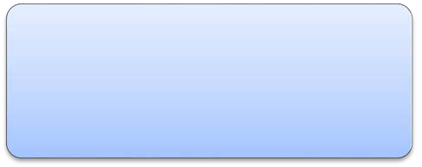
NuGet Packages
NuGet and Advantages
A free extension for Visual Studio that makes it efficient to look for all the open-source packages and use them in projects.
Is a free package management system, which allows sharing code.
Makes it simple to add, update, and delete libraries in projects that rely on the .NET Framework.
Automates the tasks of installing, setting up, and updating packages or components in a Visual Studio project.
Allow developers to reuse their own code across their own projects.

Slide 14
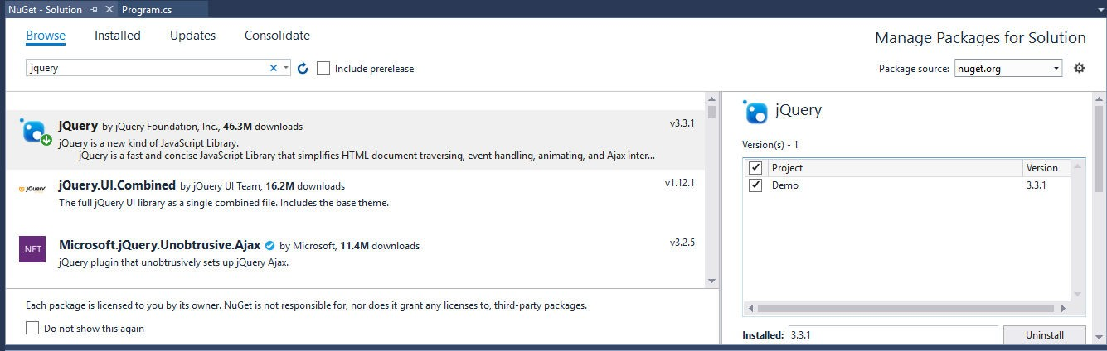
Using NuGet to Install a Package 1-3
Go to Solution Explorer.
Right-click a project solution.
Select Manage NuGet Packages for Solution. The NuGet – Solution window is displayed. This is the NuGet Package Manager.
NuGet – Solution Window
Enter the name of the desired package in the search field on the top.
Select the package from the list box and its corresponding details such as description, version, author, and license.
Select a suitable version from the Version drop-down list.

Slide 15
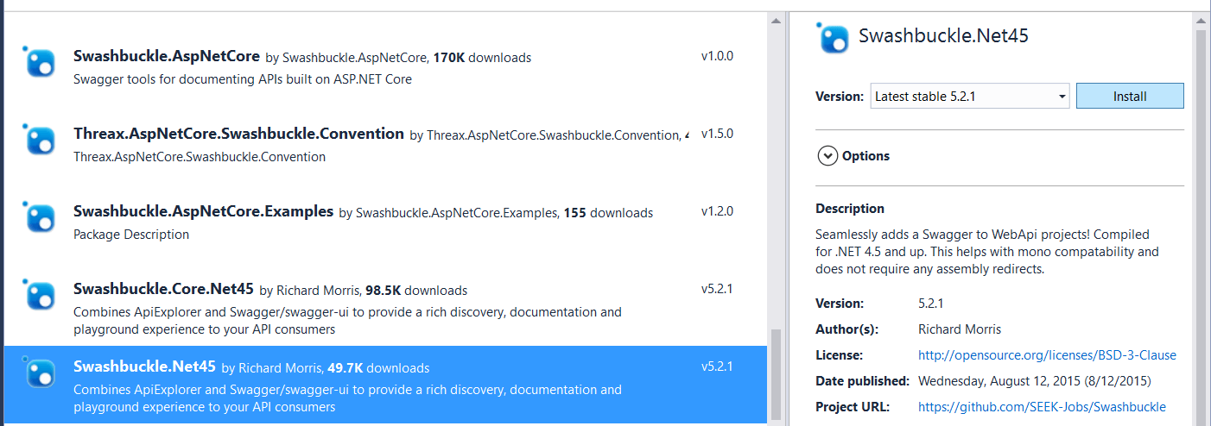

Using NuGet to Install a Package 2-3
Package Details
Click Install to add the package.
Accept all prompts regarding licensing. The Choose NuGet Package Manager Format
dialog box will be displayed.
Click OK. The Output window at the bottom of Visual Studio IDE displays a message that the package is installed successfully.
For installing a package, it is essential to specify the right source for it.
Package Source

Slide 16

Using NuGet to Install a Package 3-3
Following are some ways to install a NuGet package:
By using command window in the project folder and dotnet.exe command as: dotnet add package <package_name> which obtains the package as per its name, puts its contents into the current directory, and refers to it
By using the Package Manager Console (Tools → NuGet Package Manager → Package Manager Console) and entering the install package <package_name> command. The command obtains the package and its dependencies from a chosen source and installs it into the project
By using nuget.exe and entering the nuget package
<package_name> command

Slide 17
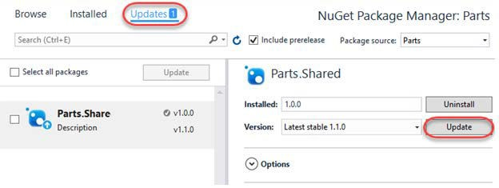
Using NuGet to Update a Package
The Updates tab of the NuGet – Solution window allows updating the installed packages. It shows the packages whose updates are available from the chosen package sources.
Updates Tab

Slide 18
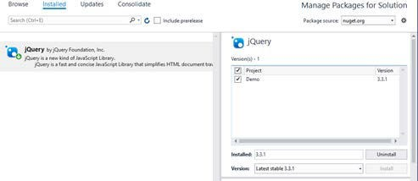
Using NuGet to Uninstall a Package
The Installed tab of the NuGet – Solution window allows updating or uninstalling the installed packages.
Installed Tab

Slide 19
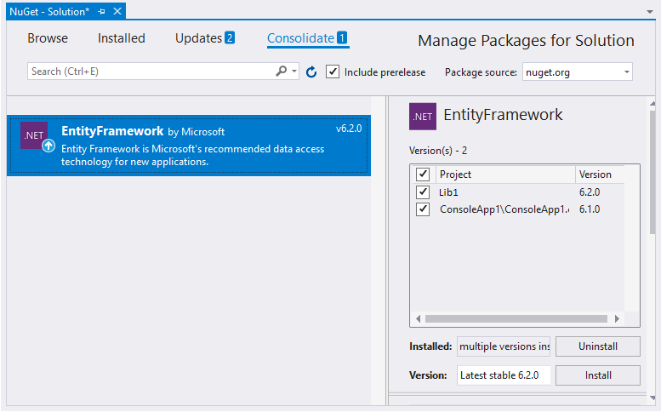
Using NuGet to Monitor Packages
If different versions of NuGet package are in use, it is possible to manage or merge them using the Consolidate tab of the NuGet – Solution window.
Consolidate Tab

Slide 20
Summary 1-2
Developers should start testing an application in the debug mode, as it provides comprehensive details while building the application.
The Visual Studio debugger allows inspecting what the targeted program does while it is executing.
In the debug mode, breakpoints as special indicators inform the debugger to stop the program’s execution when it arrives at a targeted line of code.
Visual Studio allows executing the current line and then move to the next one using the Debug → Step Over option.
The Debug → Step Into option allows executing each line of code within a method or functionality for troubleshooting it.
The Autos, Locals, and Immediate windows allow viewing the status and values of variables and objects while debugging.
20

Slide 21
Summary 2-2
The Run to Click feature is useful for debugging from one line to another in a block by simply clicking the icon rather than inserting breakpoints.
NuGet is a free extension in Visual Studio 2017 that allows integrating the third-party packages in one to two clicks in a project.
A NuGet package is a ZIP file containing all compiled code, a manifest file, and some more files associated with the code.
In Visual Studio 2017, the integrated NuGet Package Manager installs, updates, and removes packages.
21

